Slide 1

Scractching the surface of social cohesion Data Science Final Project
By Tsedey Aragie
filmstockinc@gmail.com

Slide 2
The problem or challenge
What makes a cohesive nation?
How is social cohesion measured? In my dataset there are 12 indicators and each of them have an assigned value for each of the 178 countries. The nations are ranked with #1 being the least cohesive least stable country, and 178 as the most stable most cohesive country.

Slide 3
Fragile State Index by Fund For Peace
C1: Security Apparatus
C2: Factionalized Elites
C3: Group Grievance
E1: Economic Decline &Poverty
E2: Uneven Economic Development
E3: Human Flight & Brain Drain
P1: State Legitimacy
P2: Public Services
P3: Human Rights & Rule of Law
S1: Demographic Pressures
S2: Refugees & IDPs Internally Displaced Persons
X1: External Intervention
12 Indicators

Slide 4
C1 Security Apparatus
security threats to a state, such as bombings, attacks and battle-related deaths, rebel movements, mutinies, coups, or terrorism.
takes into account serious criminal factors, such as organized crime and homicides, and perceived trust of citizens in domestic security.
C2 Factionalized Elites
fragmentation of state institutions along ethnic, class, clan, racial or religious lines, as well as and brinksmanship and gridlock between ruling elites.
It also factors the use of nationalistic political rhetoric by ruling elites, often in terms of nationalism, xenophobia, communal irredentism (e.g., a “greater Serbia”) or of communal solidarity (e.g., “ethnic cleansing” or “defending the faith”). In extreme cases, it can be representative of the absence of legitimate leadership widely accepted as representing the entire citizenry
C3 Group Grievance
focuses on divisions and schisms between different groups in society – particularly divisions based on social or political characteristics – and their role in access to services or resources, and inclusion in the political process.
may also have a historical component, where aggrieved communal groups cite injustices of the past, sometimes going back centuries, that influence and shape that group’s role in society and relationships with other groups. This history may in turn be shaped by patterns of real or perceived atrocities or “crimes” committed with apparent impunity against communal groups

Slide 5
E1 Economic Decline & Poverty
considers factors related to economic decline within a country. For example, the Indicator looks at patterns of progressive economic decline of the society as a whole as measured by per capita income, Gross National Product, unemployment rates, inflation, productivity, debt, poverty levels, or business failures
sudden drops in commodity prices, trade revenue, or foreign investment, and any collapse or devaluation of the national currency.
E2 Uneven Economic Development
inequality within the economy, irrespective of the actual performance of an economy.
looks at structural inequality that is based on group (such as racial, ethnic, religious, or other identity group) or based on education, economic status, or region (such as urban-rural divide)
E3 Human Flight & Brain Drain
considers the economic impact of human displacement (for economic or political reasons) and the consequences this may have on a country’s development.
voluntary emigration of the middle class – particularly economically productive segments of the population, such as entrepreneurs, or skilled workers such as physicians – due to economic deterioration in their home country and the hope of better opportunities farther afield

Slide 6
P1 State Legitimacy
the representativeness and openness of government and its relationship with its citizenry.
looks at the population’s level of confidence in state institutions and processes, and assesses the effects where that confidence is absent, manifested through mass public demonstrations, sustained civil disobedience, or the rise of armed insurgencies.
P2 Public Services
presence of basic state functions that serve the people. On the one hand, this may include the provision of essential services, such as health, education, water and sanitation, transport infrastructure, electricity and power, and internet and connectivity
it may include the state’s ability to protect its citizens, such as from terrorism and violence, through perceived effective policing
P3 Human Rights & Rule of Law
considers the relationship between the state and its population insofar as fundamental human rights are protected and freedoms are observed and respected.
The Indicator looks at whether there is widespread abuse of legal, political and social rights, including those of individuals, groups and institutions (e.g. harassment of the press, politicization of the judiciary, internal use of military for political ends, repression of political opponents). The Indicator also considers outbreaks of politically inspired (as opposed to criminal) violence perpetrated against civilians.

Slide 7
S1 Demographic Pressures
considers pressures upon the state deriving from the population itself or the environment around it.
Indicator measures population pressures related to food supply, access to safe water, and other life-sustaining resources, or health, such as prevalence of disease and epidemics.
S2 Refugees & IDPs
measures the pressure upon states caused by the forced displacement of large communities as a result of social, political, environmental or other causes, measuring displacement within countries, as well as refugee flows into others.
measures refugees by country of Asylum, recognizing that population inflows can put additional pressure on public services, and can sometimes create broader humanitarian and security challenges for the receiving state, if that state does not have the absorption capacity and adequate resources
X1 External Intervention
considers the influence and impact of external actors in the functioning – particularly security and economic – of a state.
focuses on security aspects of engagement from external actors, both covert and overt, in the internal affairs of a state at risk by governments, armies, intelligence services, identity groups, or other entities that may affect the balance of power (or resolution of a conflict) within a state.
demographic characteristics, such as pressures from high population growth rates or skewed population distributions, such as a “youth or age bulge,” or sharply divergent rates of population growth among competing communal groups, recognizing that such effects can have profound social, economic, and political effects.
economic engagement by outside actors, including multilateral organizations, through large-scale loans, development projects, or foreign aid, such as ongoing budget support, control of finances, or management of the state’s economic policy, creating economic dependency

Slide 8
Why I chose this topic?
Timeliness
This has been a topic of interest to me, for a while. I experience and see the world differently from a young age I have had to balance two very different worldviews, and the two countries that have shaped my identity happen to be experiencing a heightened level of social and political polarization at this time – especially in 2020.

Slide 9
Motivation
This data serves Economists, Government agencies and Non-governmental agencies both within the country and outside as a baseline for level of risk. Without this kind of data governments may have a delayed response to the urgent needs of their nation. This is also a useful resource to organizations that provide intervention services both within their country and internationally.

Slide 10
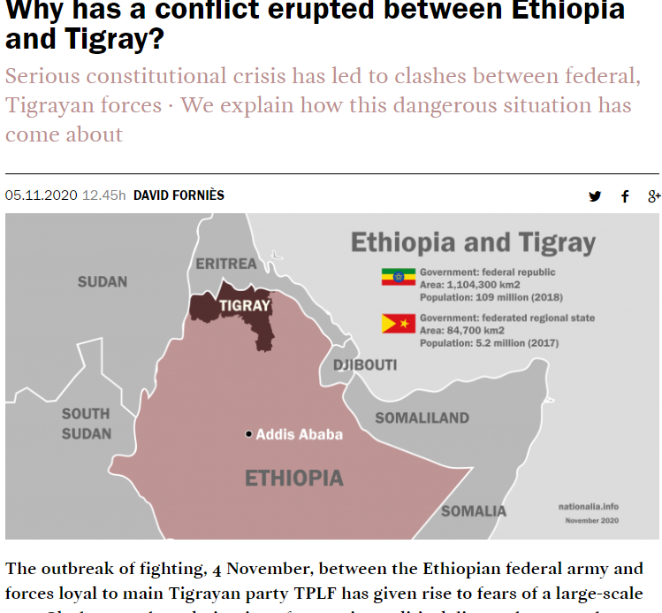
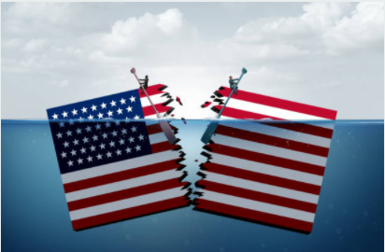
Social/Political Polarization - brewing for years
A COUNTRY DIVIDED

Slide 11
Data Source
The owner of the data, Fund For Peace, an NGO has collected data on several countries and their data set spans from year 2006-2020 – they have covered a total of 15 years and will begin working on 2020 data to be published in the Spring of 2021. I wanted to understand how they collected their data. I needed more understanding about their primary data sources and their process. and I was able to reach Nate Haken, the Programs Director at Fund For Peace. He shared invaluable information that I wouldn’t have been able to obtain from just looking at the website. They have a unique set of data and I was excited to find this information that spans over a decade. Especially the content and factors that they analyzed were closely related to my topic of interest.
In order to understand social cohesion you have to consider the opposite end of the spectrum, which is instability and polarization. Many of the indicators mentioned can be described as polarization metrics; cause & effects of polarization in a society. A large part of the data is captured by analyzing media coverage.

Slide 12
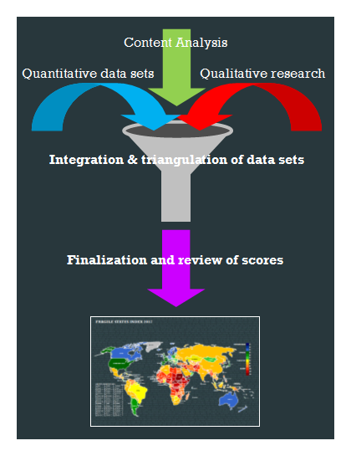
Methodology
They triangulated three different data streams to measure the 12 indicators using 1) primary data from the World Bank and UNHCR – United Nations High Commissions for Refugees, etc. 2) Content analysis of millions of online public documents using Boolean search strings to flag sharp changes from one country to the next, and 3) qualitative assessment. The approach taken is to scale and normalize the individual metrics and then integrate with weighted averages.
For the qualitative component, two separate teams of analysts independently conduct a qualitative analysis to assess, based on major events, whether the country indicator scores got better, worse, or stayed the same. The qualitative analysis is done twice, by two different sets of analysts with a firewall between them, to reduce bias and fill gaps.
Finally the three data streams are compared to see if they generate the same outcome, and triangulated to arrive at a reconciled score.
The methodology was pretty consistent for each year, beginning with 147 countries in 2006 and expanding to a total of 178 countries on their current list.

Slide 13
The hypothesis (or prediction)
Stable nations have minimal grievances, and minimum human rights violations.
Definition: Social cohesion is the absence of polarization and divison. Also defined as ‘stable’ or ‘very stable’ nations.

Slide 14
My testing method
What methods and databases were used for my analysis?
Machine Learning, Supervised, Regression
Keras sequential, nn-model, deep-model, and linear regression.
P-value – testing the null hypothesis
Databases: Pandas, Numpy, Tensorflow, Sklearn (preprocessing, model_slection, metrics, linear model, and matplotlib.
Supervised ML
Regression &
Linear Regression

Slide 15
Keras
Results for target metric Fractionalized Elites
Nn model: R² value for y_train = .76 and y_test = .66
Deep model: R² value for y_train = .80 and y_test .70
The results were slightly varied due to the nature of the algorithm but the accuracy scores are around 82% across different indicators.
I created the sequential model and added layers to nn-model and deep-model. The nn-model has two hidden layers, and the deep-model has four hidden layers.

Slide 16
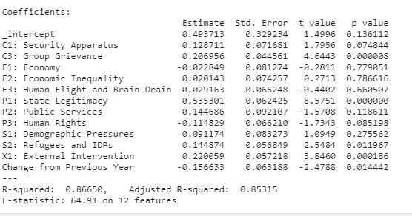
P-Value results
Similar outcomes for both train and test. The indicators that were most corelated to Fractionalized elites were: P1: State Legitimacy and
C3: Group Grievance and
X1: External Intervention

Slide 17
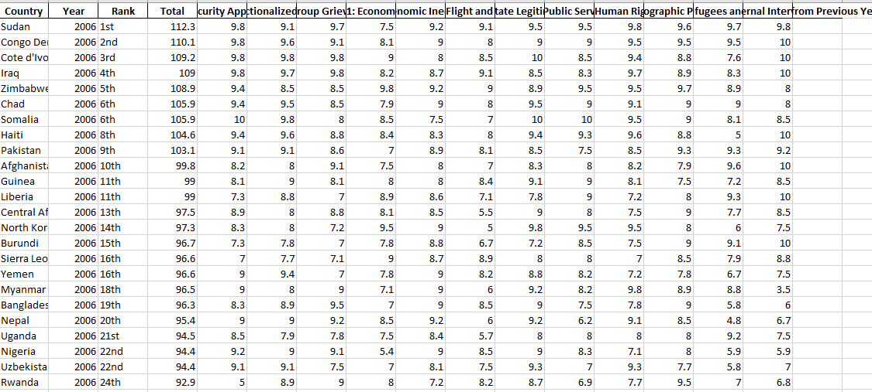
Data Pre Processing
Cleaned and organized the data before running through the model.
Merged the years 2006-2020 onto one sheet
Removed columns: Country, Year, Total, and Rank.
X variable = Indicator (target metric)

Slide 18
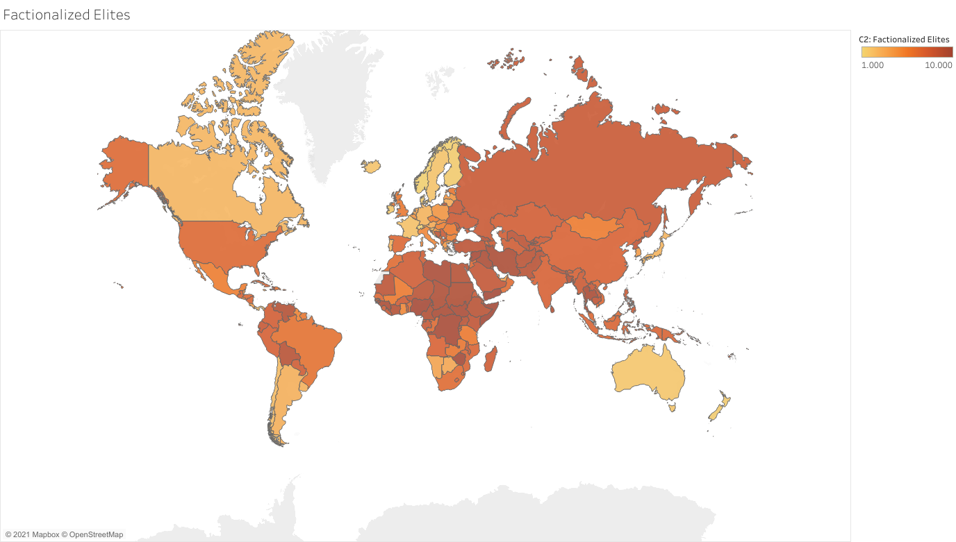
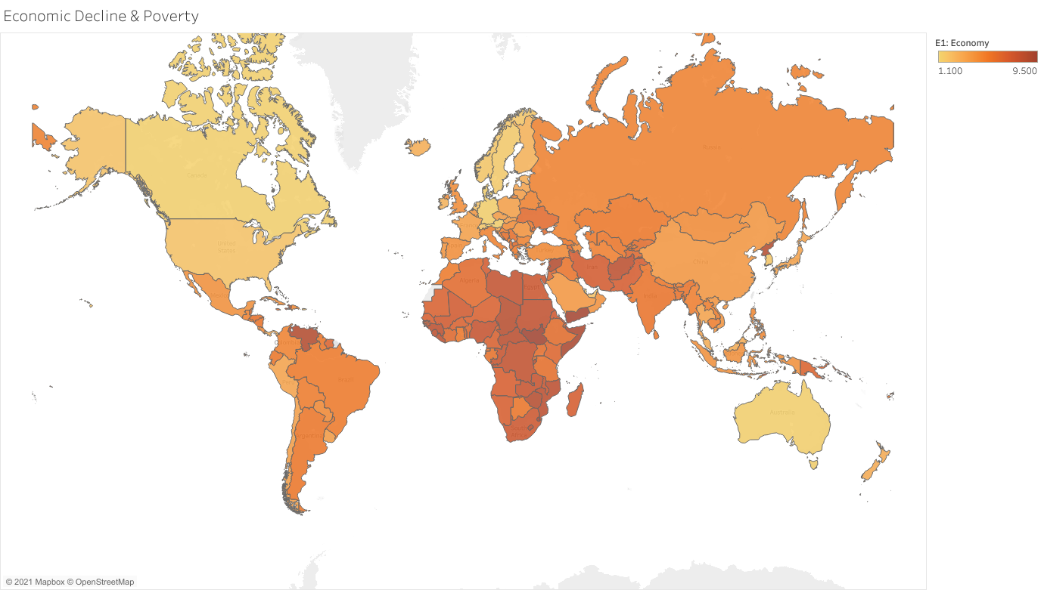
A comparative view
The assumption is that wealthy nations are socially cohesive. The nations with very low values of decline are also experiencing heightened levels of fragmentation.
15
Dashboard from Tableau

Slide 19
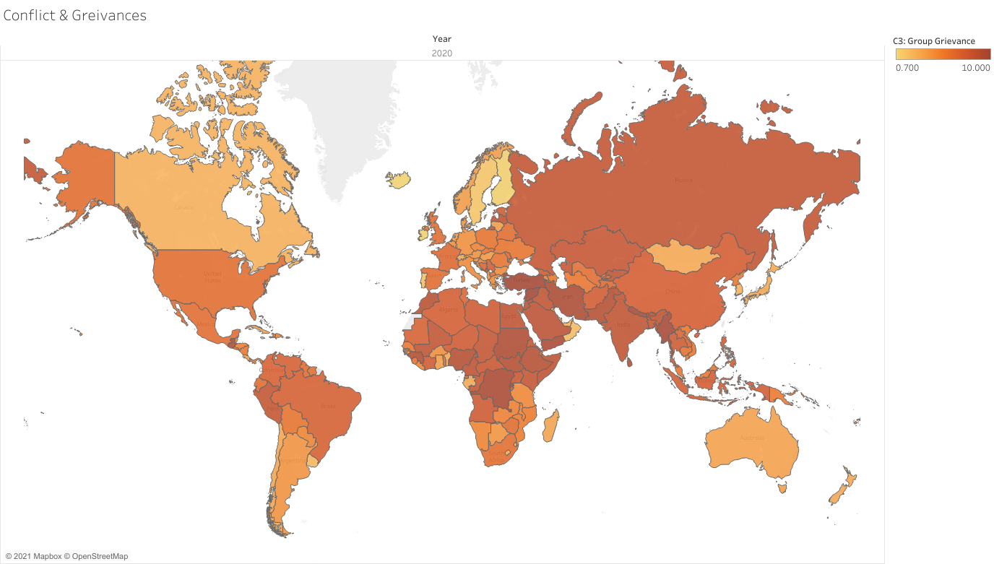
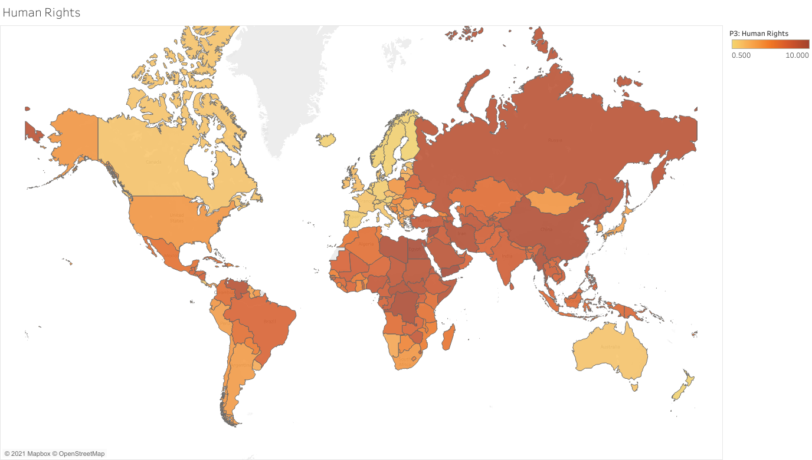
A comparative view
The assumption: C3: grievances are correlated to a populations sense of perceived freedom and P3: Human Rights & rule of law
15
Dashboard from Tableau

Slide 20
Tableau
https://public.tableau.com/profile/tsedey.aragie#!/vizhome/DataViz_fragilestateindex/C-indicators?publish=yes
Dashboard

Slide 21
Conclusion
Understanding the data source is critical to how confident I can be about the conclusion and story that I wish to draw upon.
Although I find the metrics that they have selected to be superior. It’s a bit puzzling to analyze all of these nations based on one or three languages. There are 178 countries, and to have a better understanding of social cohesion more data needs to be collected in these different languages. A part of accurately measuring social cohesion should include the way a nations sees themself. For budget reasons maybe select 5 countries to start collecting data.

Slide 22
Always consider language (not necessairly computer language) and cultural context when analyzing data.
LL: Important Take away

Slide 23

What will I do next?
I would like to do a comparative review of the data over the past 10 years and then select certain countries that have experienced polarization and decline of social cohesion resulting in some level of genoicde and analyze what kind of news reports were published both international news agencies and within the country.

